Slide 1

St. Pete IoT
Brought to you by

Slide 2
St. Pete IoT
Brought to you by
Nicolas Mejia (FW Nick)

Slide 3
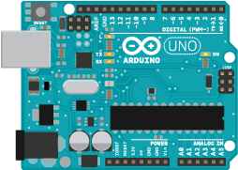
Today’s Agenda
Arduino
Them downloads…
What is Arduino?
What can we do with it?
C and C++
What is C?
Datatypes, Functions n’ stuff…
Embedded Topics
Program Flow
Lets make a program
Image from Arduino.cc

Slide 4
Arduino
Development kit for that contains
Microcontroller
USB connection
Headers for GPIOs

Slide 5
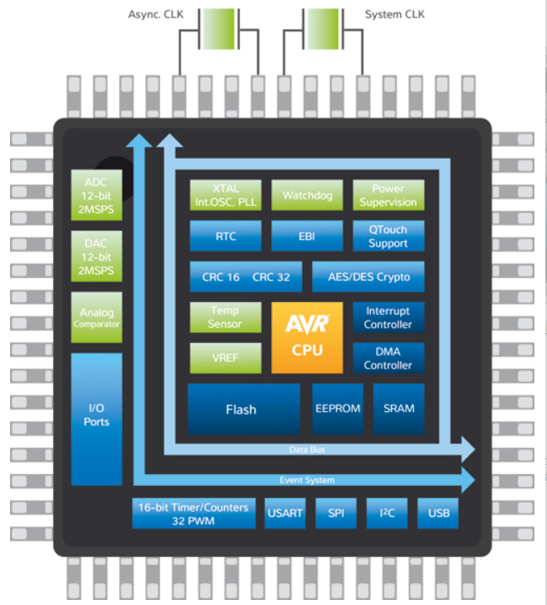
Microcontrollers
Typical Contents
CPU
Memory
Flash
Ram
Peripherals
Image from Atmel.com

Slide 6
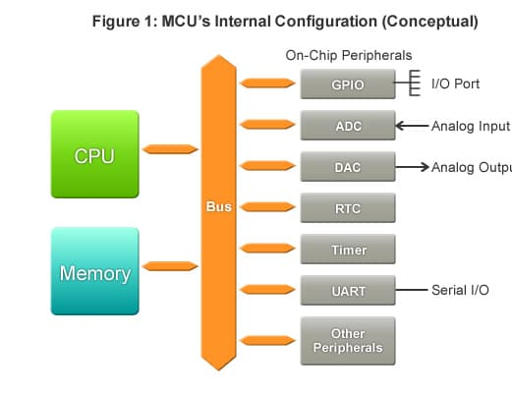
Peripherals
Receive
Send
Process
Image from Renasas.com

Slide 7
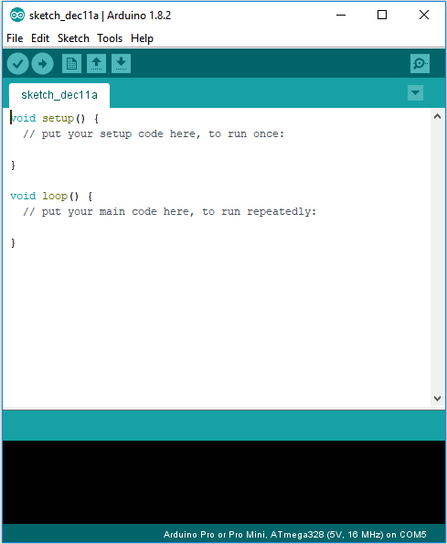
How do we use an Arduino?
C or C++
Arduino IDE is needed

Slide 8
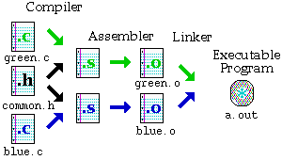
The magic of C programming
Image from Dartmouth.edu

Slide 9
Arduino Flow
SETUP
LOOP

Slide 10
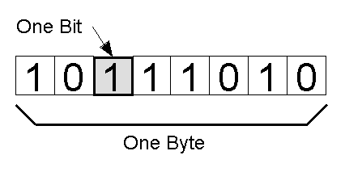
Programming
Data and Datatypes
void
boolean (1 byte)
char (1 byte)
int (2 bytes)
float (4 bytes)
…etc
Find more at https://playground.arduino.cc/Code/DatatypePractices
Image from Quora.com

Slide 11
Programming
Keywords mold the language
setup
loop
int
return
if
switch
break
while
Compiler directives
#define
#include

Slide 12
Programming
Functions = Datatypes + Operations + Other functions(optional)
Functions can return values
int my_function(int a)
{
return a + 1;
}
Functions may be referenced and defined in Libraries (.h files)

Slide 13
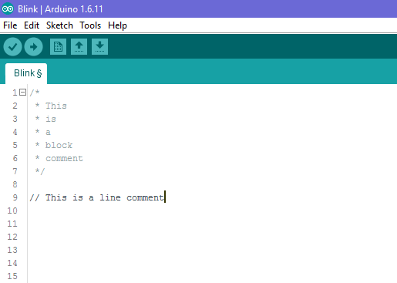
Comments

Slide 14
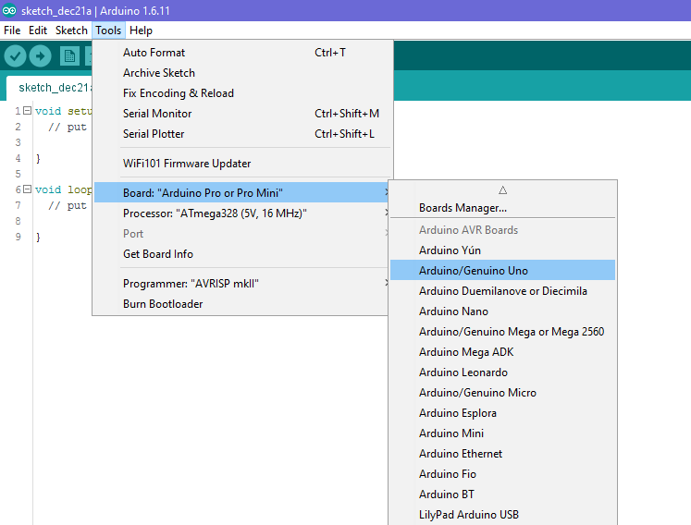

Slide 15
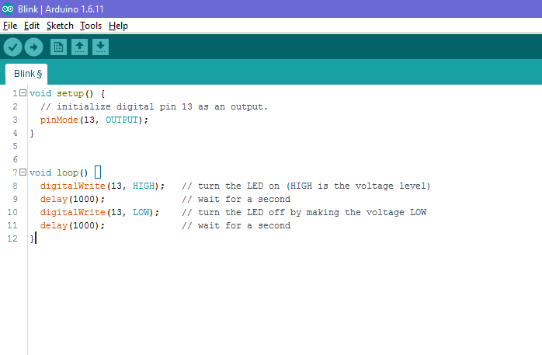

Slide 16


Slide 17
Programming
More information on Arduino API (the set of Arduino-specific programming functions that you can use): https://www.arduino.cc/reference/en/

